Slide 1
Data Visualisation: Principles and practical applications in Excel
Dr Jon Minton
Applied Quantitative Methods Network (AQMeN)
University of Glasgow
Jonathan.minton@glasgow.ac.uk

Slide 2
Course Structure
Morning
Principles and concepts of data visualisation
Data management
Longer-term suggestions
Afternoon
Some data management & visualisation recipes and ‘hacks’
Group exercises
Presentations

Slide 3
Statistical Inference and Data Visualisation
Complementary Roles
Statistical Inference lowers the hurdle
Data Visualisation lets people jump higher

Slide 4
Brief history of data visualisation
Playfair
Minard
Snow
Nightingale
Tukey
Tufte
Few
Wilkinson/Wickham

Slide 5
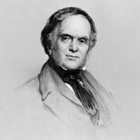
William Playfair
Born 1759
Died 1823
Architect
Mathematician
Economist

Slide 6
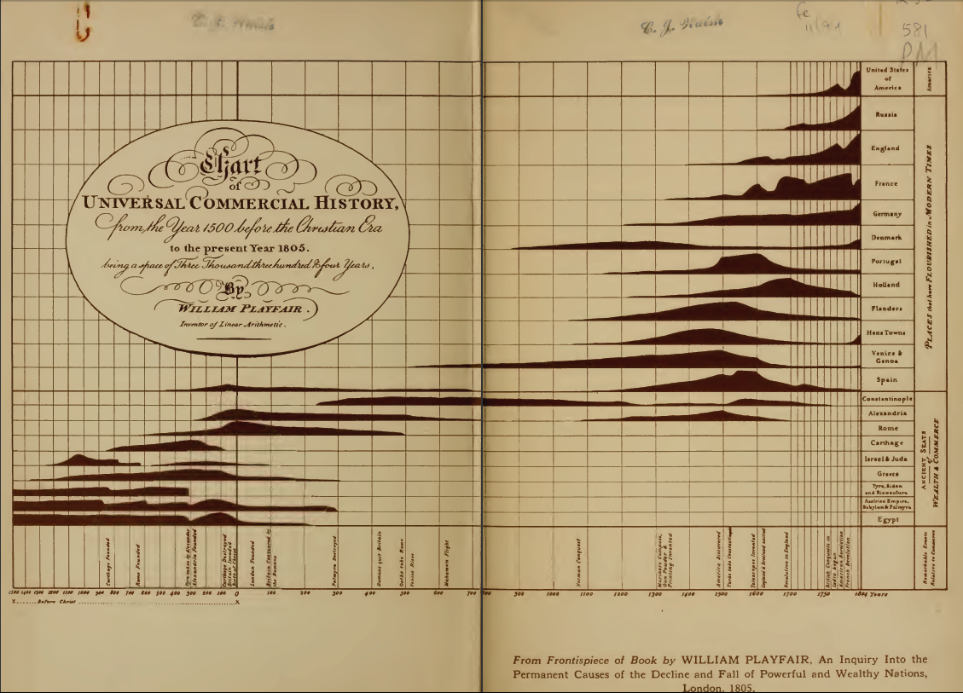
William Playfair

Slide 7
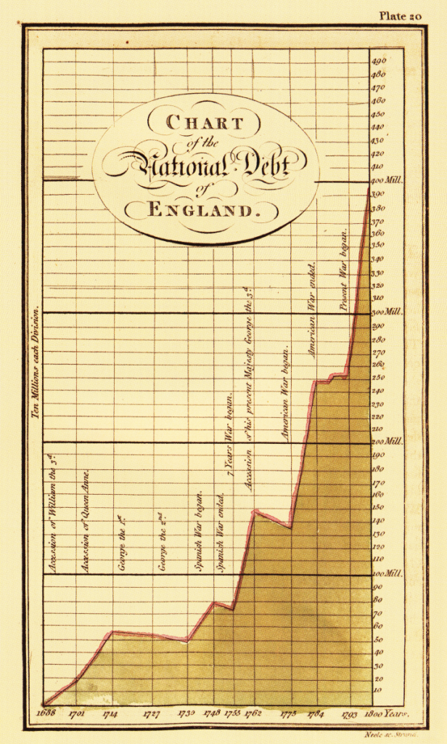
William Playfair
Note the use of
proportions
Visualisations as rhetoric

Slide 8

Charles Minard
Born 1781
Died 1870
Civil Engineer until 1851
Retired* from 1852
* This is when he produced most of his visualisations

Slide 9
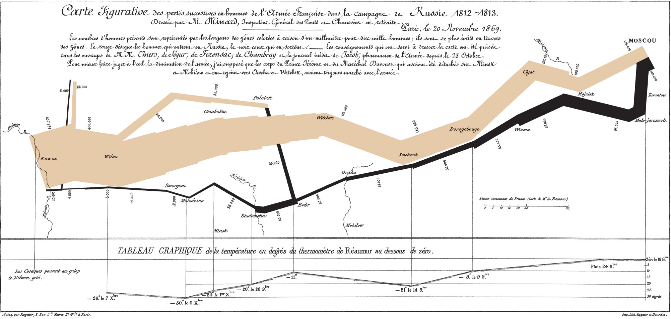
Charles Minard
“...the best statistical graphic ever drawn”? – Edward Tufte

Slide 10
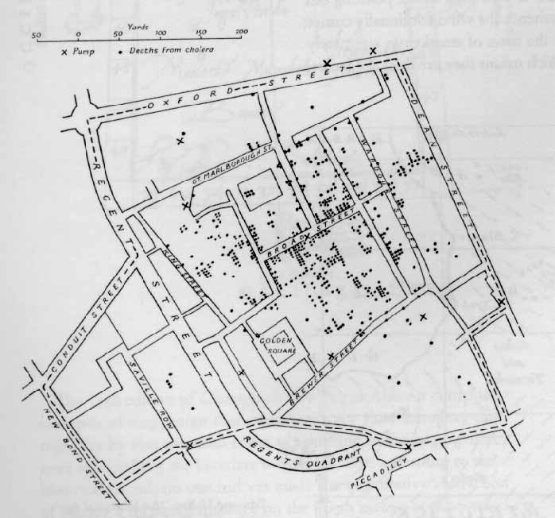
History of Data Visualisation
The Milestones Project (Continued)
1855: Dot maps to identify origin of a cholera outbreak in London (John Snow)
Dots save lives

Slide 11
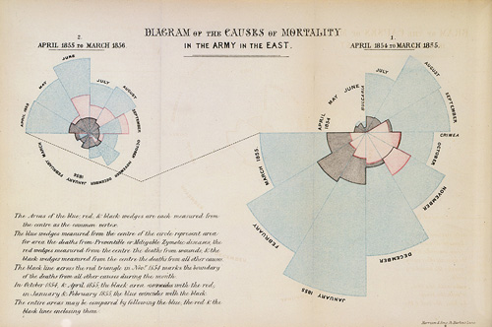
History of Data Visualisation
The Milestones Project (Continued)
1857: Polar area charts AKA coxcombs (Florence Nightingale)
Wedges save lives

Slide 12
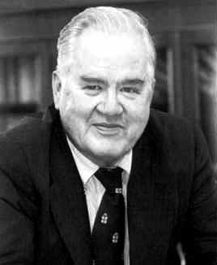
John Tukey
Born 1915
Died 2000
Mathematician
(Electronic Engineer)
Contributions to data visualisation:
Box plots
‘Exploratory Data Analysis’

Slide 13
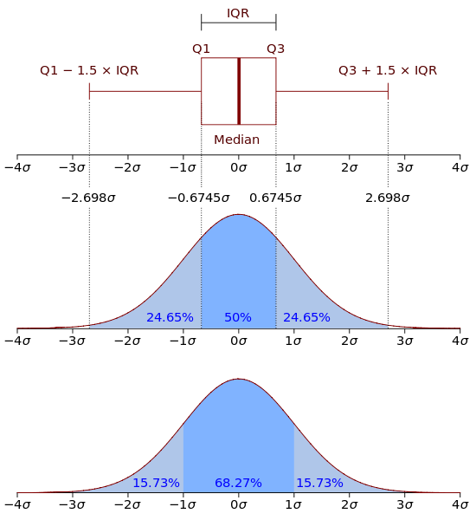
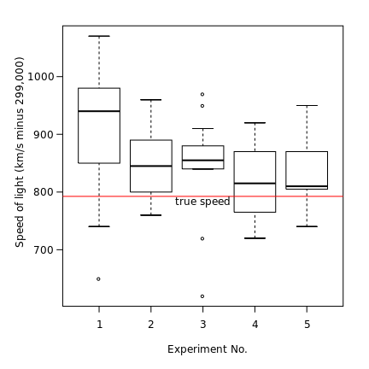
John Tukey
Box plots
Visual representation of a number of key statistics used to summarise a sample of observations

Slide 14
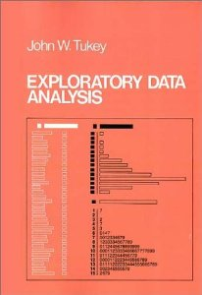
John Tukey
Exploratory Data Analysis
Crudely:
A series of (mainly visual) methods for trying to be less dependent on summary statistics and the assumptions used to construct them.

Slide 15
Why use visualisation for Exploratory Data Analysis?
I |  | II |  | III |  | IV
x | y | x | y | x | y | x | y
10.0 | 8.04 | 10.0 | 9.14 | 10.0 | 7.46 | 8.0 | 6.58
8.0 | 6.95 | 8.0 | 8.14 | 8.0 | 6.77 | 8.0 | 5.76
13.0 | 7.58 | 13.0 | 8.74 | 13.0 | 12.74 | 8.0 | 7.71
9.0 | 8.81 | 9.0 | 8.77 | 9.0 | 7.11 | 8.0 | 8.84
11.0 | 8.33 | 11.0 | 9.26 | 11.0 | 7.81 | 8.0 | 8.47
14.0 | 9.96 | 14.0 | 8.10 | 14.0 | 8.84 | 8.0 | 7.04
6.0 | 7.24 | 6.0 | 6.13 | 6.0 | 6.08 | 8.0 | 5.25
4.0 | 4.26 | 4.0 | 3.10 | 4.0 | 5.39 | 19.0 | 12.50
12.0 | 10.84 | 12.0 | 9.13 | 12.0 | 8.15 | 8.0 | 5.56
7.0 | 4.82 | 7.0 | 7.26 | 7.0 | 6.42 | 8.0 | 7.91
5.0 | 5.68 | 5.0 | 4.74 | 5.0 | 5.73 | 8.0 | 6.89
The Anscombe Quartet (1973)

Slide 16
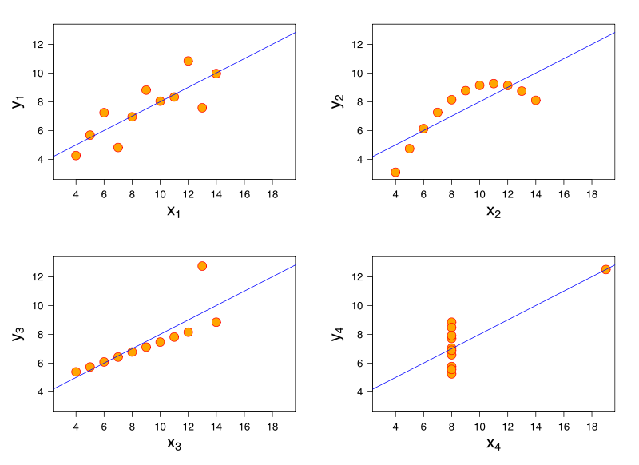
Why use visualisation for Exploratory Data Analysis?
I |  | II |  | III |  | IV
x | y | x | y | x | y | x | y
10.0 | 8.04 | 10.0 | 9.14 | 10.0 | 7.46 | 8.0 | 6.58
8.0 | 6.95 | 8.0 | 8.14 | 8.0 | 6.77 | 8.0 | 5.76
13.0 | 7.58 | 13.0 | 8.74 | 13.0 | 12.74 | 8.0 | 7.71
9.0 | 8.81 | 9.0 | 8.77 | 9.0 | 7.11 | 8.0 | 8.84
11.0 | 8.33 | 11.0 | 9.26 | 11.0 | 7.81 | 8.0 | 8.47
14.0 | 9.96 | 14.0 | 8.10 | 14.0 | 8.84 | 8.0 | 7.04
6.0 | 7.24 | 6.0 | 6.13 | 6.0 | 6.08 | 8.0 | 5.25
4.0 | 4.26 | 4.0 | 3.10 | 4.0 | 5.39 | 19.0 | 12.50
12.0 | 10.84 | 12.0 | 9.13 | 12.0 | 8.15 | 8.0 | 5.56
7.0 | 4.82 | 7.0 | 7.26 | 7.0 | 6.42 | 8.0 | 7.91
5.0 | 5.68 | 5.0 | 4.74 | 5.0 | 5.73 | 8.0 | 6.89
The Anscombe Quartet (1973)

Slide 17

Edward Tufte
Born 1942
Statistician
Sculptor
Advisor to Obama
Contributions to data visualisation
Conceptual Tools
Data Ink Ratios
Lie Factors
Chart Junk
Visualisations
Small multiples
Sparklines

Slide 18
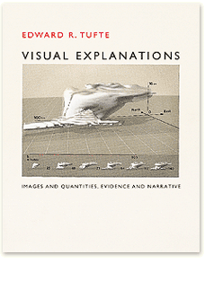
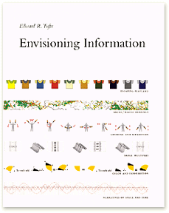

Books by Edward Tufte

Slide 19

Steven Few
Data visualisation consultant
www.perceptualedge.com
Tufte-inspired unfussy informative data visualisation
Practical, Excel-focused books
Show Me The Numbers
Information Dashboard Design
Now You See It

Slide 20
Leland Wilkinson and Hadley Wickham
Wilkinson
The Grammar of Graphics 2000 [2005]
A language and set of terms for thinking more clearly about the construction of data visualisations
Hadley Wickham
ggplot2 2009 onwards
A very popular implementation of gg principles

Slide 21
Data Visualisation is…
…the development and consistent application of rules for mapping between data and graphics.
(equivalently) ... using quantitative (statistical) data as instructions for the production of images.
A necessary condition for something to be a data visualisation; but not a sufficient condition for something to be a good data visualisation

Slide 22
The Three Hats
Three different skill sets
Three different mind sets
What are they?

Slide 23
The Three Hats
Scientist
Artist
Engineer

Slide 24
The Engineer must have broad shoulders
S
A
E

Slide 25
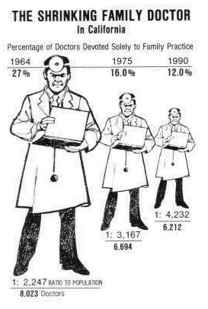
Are your visualisations... lying?
What’s the ‘lie factor’?
- Edward Tufte
“
The representation of numbers, as physically measured on the surface of the graphic itself, should be directly proportional to the quantities represented
”
Tufte 1991
S
A
E

Slide 26
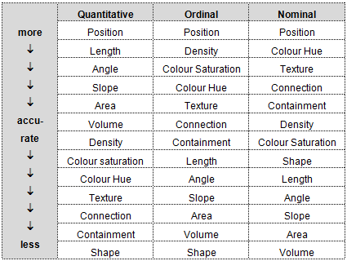
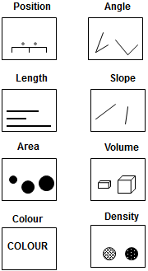
Are your visualisations... Accurately interpretable?
Cleveland W & McGill R (1985), ‘Graphical Perception and Graphical Methods for Analysing Scientific Data’, Science (229) 4716: 828-833
S
A
E

Slide 27
Are your visualisations... Sensible?
S
A
E

Slide 28
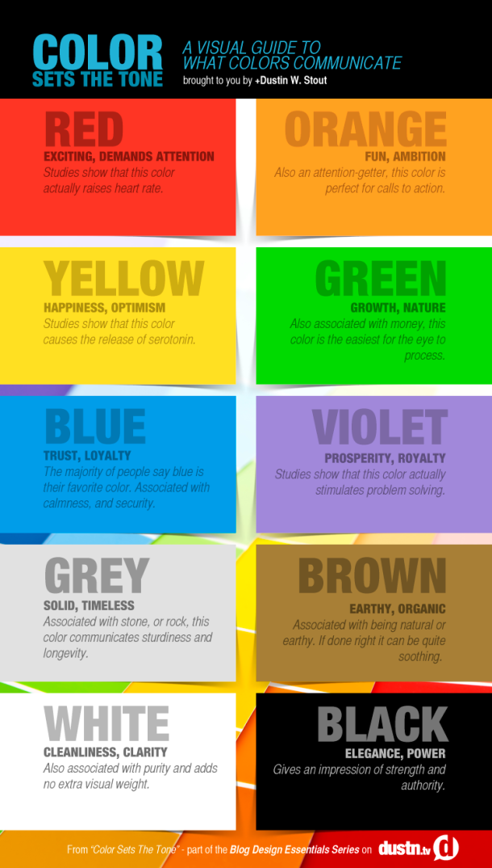
Visualisations
and colour
S
A
E

Slide 29
Why is Facebook blue?
Colour and
accessibility
S
A
E

Slide 30
Colour and
appropriateness
to variables
S
A
E

Slide 31
Circles and Squares: A faultline?
S
A
E

Slide 32
A Question
What is a good data visualisation?

Slide 33
The Answer
It depends.
Good data visualisations don’t have to be:
Quick
Simple
Easy to understand
Original
Eye-catching
What matters is how well matched the visualisation is with the audience

Slide 34
Two types of audience
Internal/Specialist
Data Visualisation as Exploratory Data Analysis
A recursive, two-way process
External/Generalist
‘Narrative’ Data Analysis
A one-way process

Slide 35
Data Visualisation is...
... using quantitative (statistical) data as instructions for the production of images.
QUESTIONS
What data?
How are the data converted into instructions?
Who/what is being instructed?
What image?

Slide 36
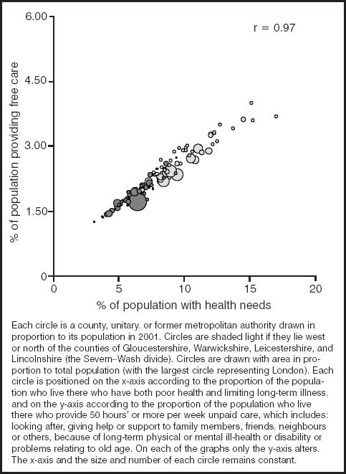
As an example...
How are data being converted into instructions here?
How many dimensions does this visualisation have?

Slide 37
As an example...
How are data being converted into instructions here?
How many dimensions does this visualisation have?
Shaw M & Dorling D (2004) “Who cares in England and Wales? The Positive Care Law: cross-sectional study” British Journal of General Practice, 54 (509): 899-903

Slide 38
Data Visualisation as Box Wiring
Data Variable |  | Graphical Aesthetic
% of population providing free care |  | Position along horizontal axis
% of population with health needs |  | Position along vertical axis
Areal unit population |  | Size of bubble
Geographical location (North or south) |  | Colour of bubble

Slide 39
Data Visualisation as Box Wiring
Data Variable |  | Graphical Aesthetic
% of population providing free care |  | Position along horizontal axis
% of population with health needs |  | Position along vertical axis
Areal unit population |  | Size of bubble
Geographical location (North or south) |  | Colour of bubble

Slide 40
Double-Encoding for Emphasis
Data Variable |  | Graphical Aesthetic
% of population providing free care |  | Position along horizontal axis
% of population with health needs |  | Position along vertical axis
Areal unit population |  | Size of bubble
Geographical location (North or south) |  | Colour of bubble

Slide 41
Layers of Data Visualisation
The Guide Layer
Scales
Coordinate Systems
Legends
The Data Layer
Transformations
Aesthetics
Geometrics
The Annotation Layer
Everything else

Slide 42
The Guide Layer: Excel Default

Slide 43
The Guide Layer: Major Gridlines

Slide 44
The Guide Layer: Major and Minor Gridlines

Slide 45
The Guide Layer: Major and Minor Gridlines

Slide 46
The Guide Layer: Gridlines Removed

Slide 47
The Guide Layer: Unit interval tickmarks

Slide 48
The Guide Layer: 1:1 Ratio

Slide 49
The Support Layer: Excel Default

Slide 50
The Geom: Points

Slide 51
The Geom: Lines

Slide 52
The Geom: Bars

Slide 53
The Geom: Area

Slide 54
The Annotation Layer

Slide 55
The Annotation Layer

Slide 56
The Annotation Layer
Fig XXX: A plot of y against x. Y represents... X represents... Note the ...Sed consequat dolor a purus molestie aliquet. Maecenas dignissim, urna nec condimentum egestas, lectus tellus interdum enim, vel viverra felis arcu eget odio. Nam placerat faucibus sem ut ornare. Etiam et nulla quam. Suspendisse dolor diam, feugiat sit amet erat sed, accumsan hendrerit erat. Aenean dictum vulputate eros, sed adipiscing erat pulvinar a. Fusce mattis convallis metus, quis te.
Data source:...

Slide 57
The Annotation Layer
Sed at dui at urna ullamcorper cursus.
Aenean suscipit
Aenean suscipit
Aenean suscipit semper tortor eu suscipit. Vestibulum ante ipsum primis in faucibus orci luctus et ultrices posuere cubilia Curae
Data source:...

Slide 58
Tidy Data
Very important
Useful things to know
Importing from plain text
Importing from web tables
Exporting
Cleaning
Formatting
Rearranging Data
S
A
E

Slide 59
Key ideas
Pipes and porcelin: Plumbing and architecture
Research as plumbing
Information for humans, data for computers
Tidy data concepts and ideas
The target structure
‘Messy data’ examples
Tools for data tidying
Further reading

Slide 60
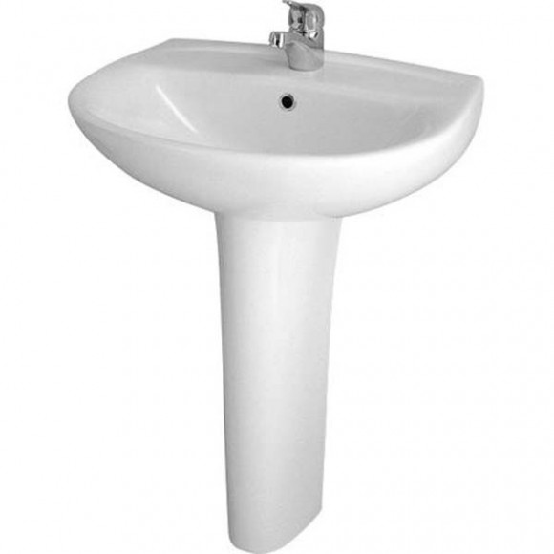
Pipes and porcelin
What are your needs as a user?
What needs to happen to meet your needs?
What can go wrong? How are problems fixed?

Slide 61
Academic Research is architecture AND plumbing
 | Essay Writing | Qualitative Research | Quantitative Research
Architecture
Plumbing

Slide 62
Information and data
People want information
Computers need data

Slide 63
Example: Car and Van ownership in Scotland
Why might we be interested in car and van ownership in Scotland, and how it has changed between 2001 and 2011?
What are the differences between each of these files?
2001 census
Initial file
Modified
2011 census
Initial file
Modified
Combined

Slide 64
Data tidying for easier control
Tap controls
Up: more; down: less
Left: warmer; right: colder
An important aim of data management is to get the data into a form where you can control what you get more easily
How was this achieved with the previous example?

Slide 65
A target tidy data form
Datazone | Local authority | year | total | none
‘Where’ variables |  |  | ‘What’ variables
What variables: Report measured values
Where variables: Describes the characteristics of what was measured

Slide 66
Derived variables: ‘window variables’
Datazone | Local authority | year | total | none | Proportion without a car or van | Proportion with a car or van
‘Where’ variables |  |  | ‘What’ variables
Window variables make the dataset wider (More columns)
But the data still has as many rows
Example using Excel:

Slide 67
Derived variables: ‘summary variables’
Local authority | year | Total by LA and year | None by LA and year
‘Where’ variables |  | ‘What’ variables
Summary variables reduce the size (number of rows) of the data
What is the example above
Example using Excel

Slide 68
Further viewing and reading
Hadley Wickham, ‘Tidy Data’
http://www.jstatsoft.org/v59/i10/paper
Focus on the examples, not the methods/case study described later.
Hadley Wickham’s Presentation
https://vimeo.com/33727555
Again, focus on the examples

Slide 69
Tools for Data Management and Data Vis
One package or two?
Better to keep to a single package if you’re able
Excel on the road to R?
Excel
Dedicated Statistical Software
SPSS
Stata
Data visualisation
Tableau
Wickham Accented R
tidyr
dplyr
ggplot2

Slide 70
Excel Tips: Pivot-tables and pivot-charts
Pivot-tables are good for
re-arranging data
re-analyses and exploration
Pivot-charts
Adjunct to pivot-tables
Effective for exploratory data analysis

Slide 71
Excel Tips: Kludging
Tidying:
concatenate, split, remove white space, delete empty rows and columns
Window functions:
adding new columns with formula (sum, average, if statements)
Merging:
Vlookup: LEARN THIS!
Summary functions
pivot-tables
Exploratory data analysis
Pivot-tables and pivot-charts
Pasting
Links vs values

Slide 72
Excel tips: Publication visualisation
Dialogue boxes
Select data
Change chart type
Guide layer
Adjust guidelines, legends, tick values and spacing
Statistics
Trendlines and summary stats
Aesthetics
Colours, linetypes, etc
Templates
Save bespoke designs to consistently apply

Slide 73
Afternoon session
An afternoon of three parts
Part one: Some practical tips with data management (All delegates)
Part two: Split into 3-4 groups
Decide on the data to use
Decide on the type of visualisation to produce
Part three: Presentation of visualisation

Slide 74
Types of data
Census Data
Two years
Datazone and local authority
SNS Data
Housing, ethnicity, claimants
More years,
Pre-tidied

